Slide 1
GoRent
Team 7777
Guillermo Mora
Tyler Rosa
Mim Dey
Thierno Sow
Muhammad Tufail
Rishika Datta
Notes:
*Whole Group*

Slide 2
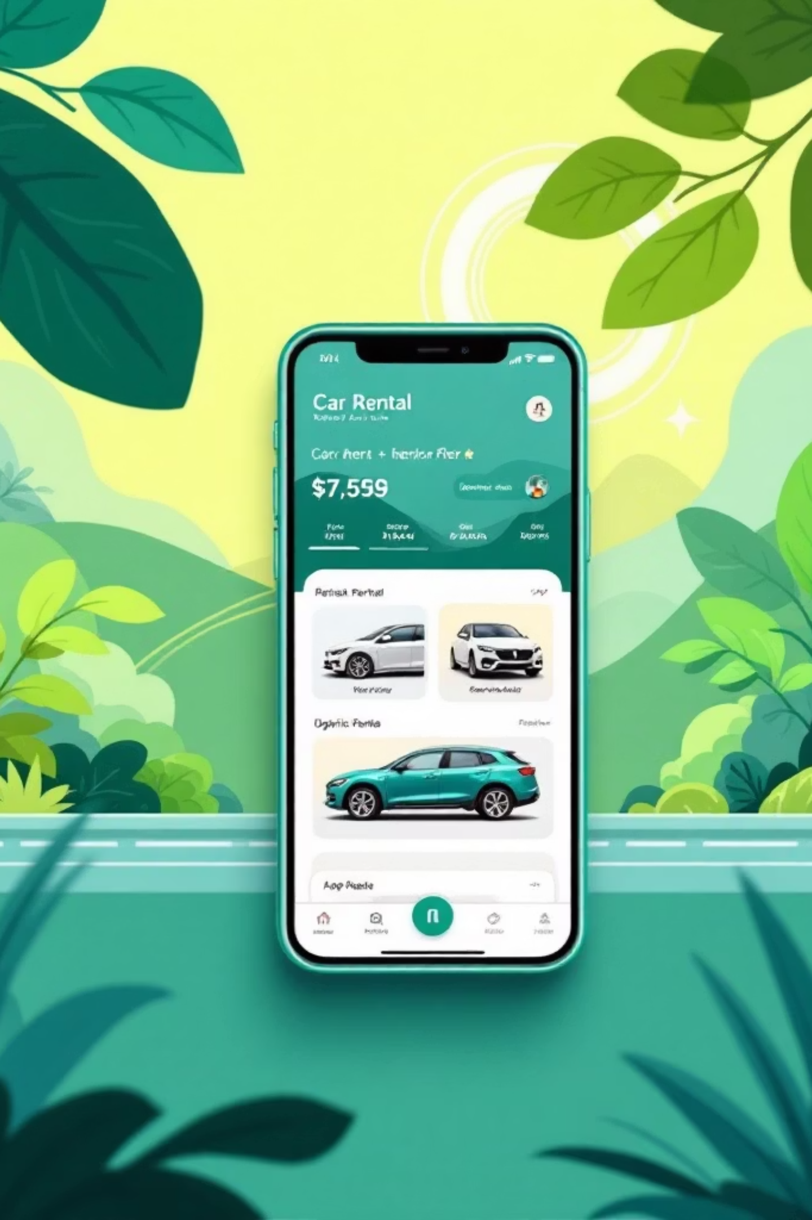
What is our app?
A peer-to-peer platform that connects car owners with renters seeking flexible, affordable vehicle access. The platform allows owners to monetize vehicles while giving renters diverse and accessible transportation options, effectively bridging supply and demand in the transportation economy.
Notes:
*Mim*

Slide 3
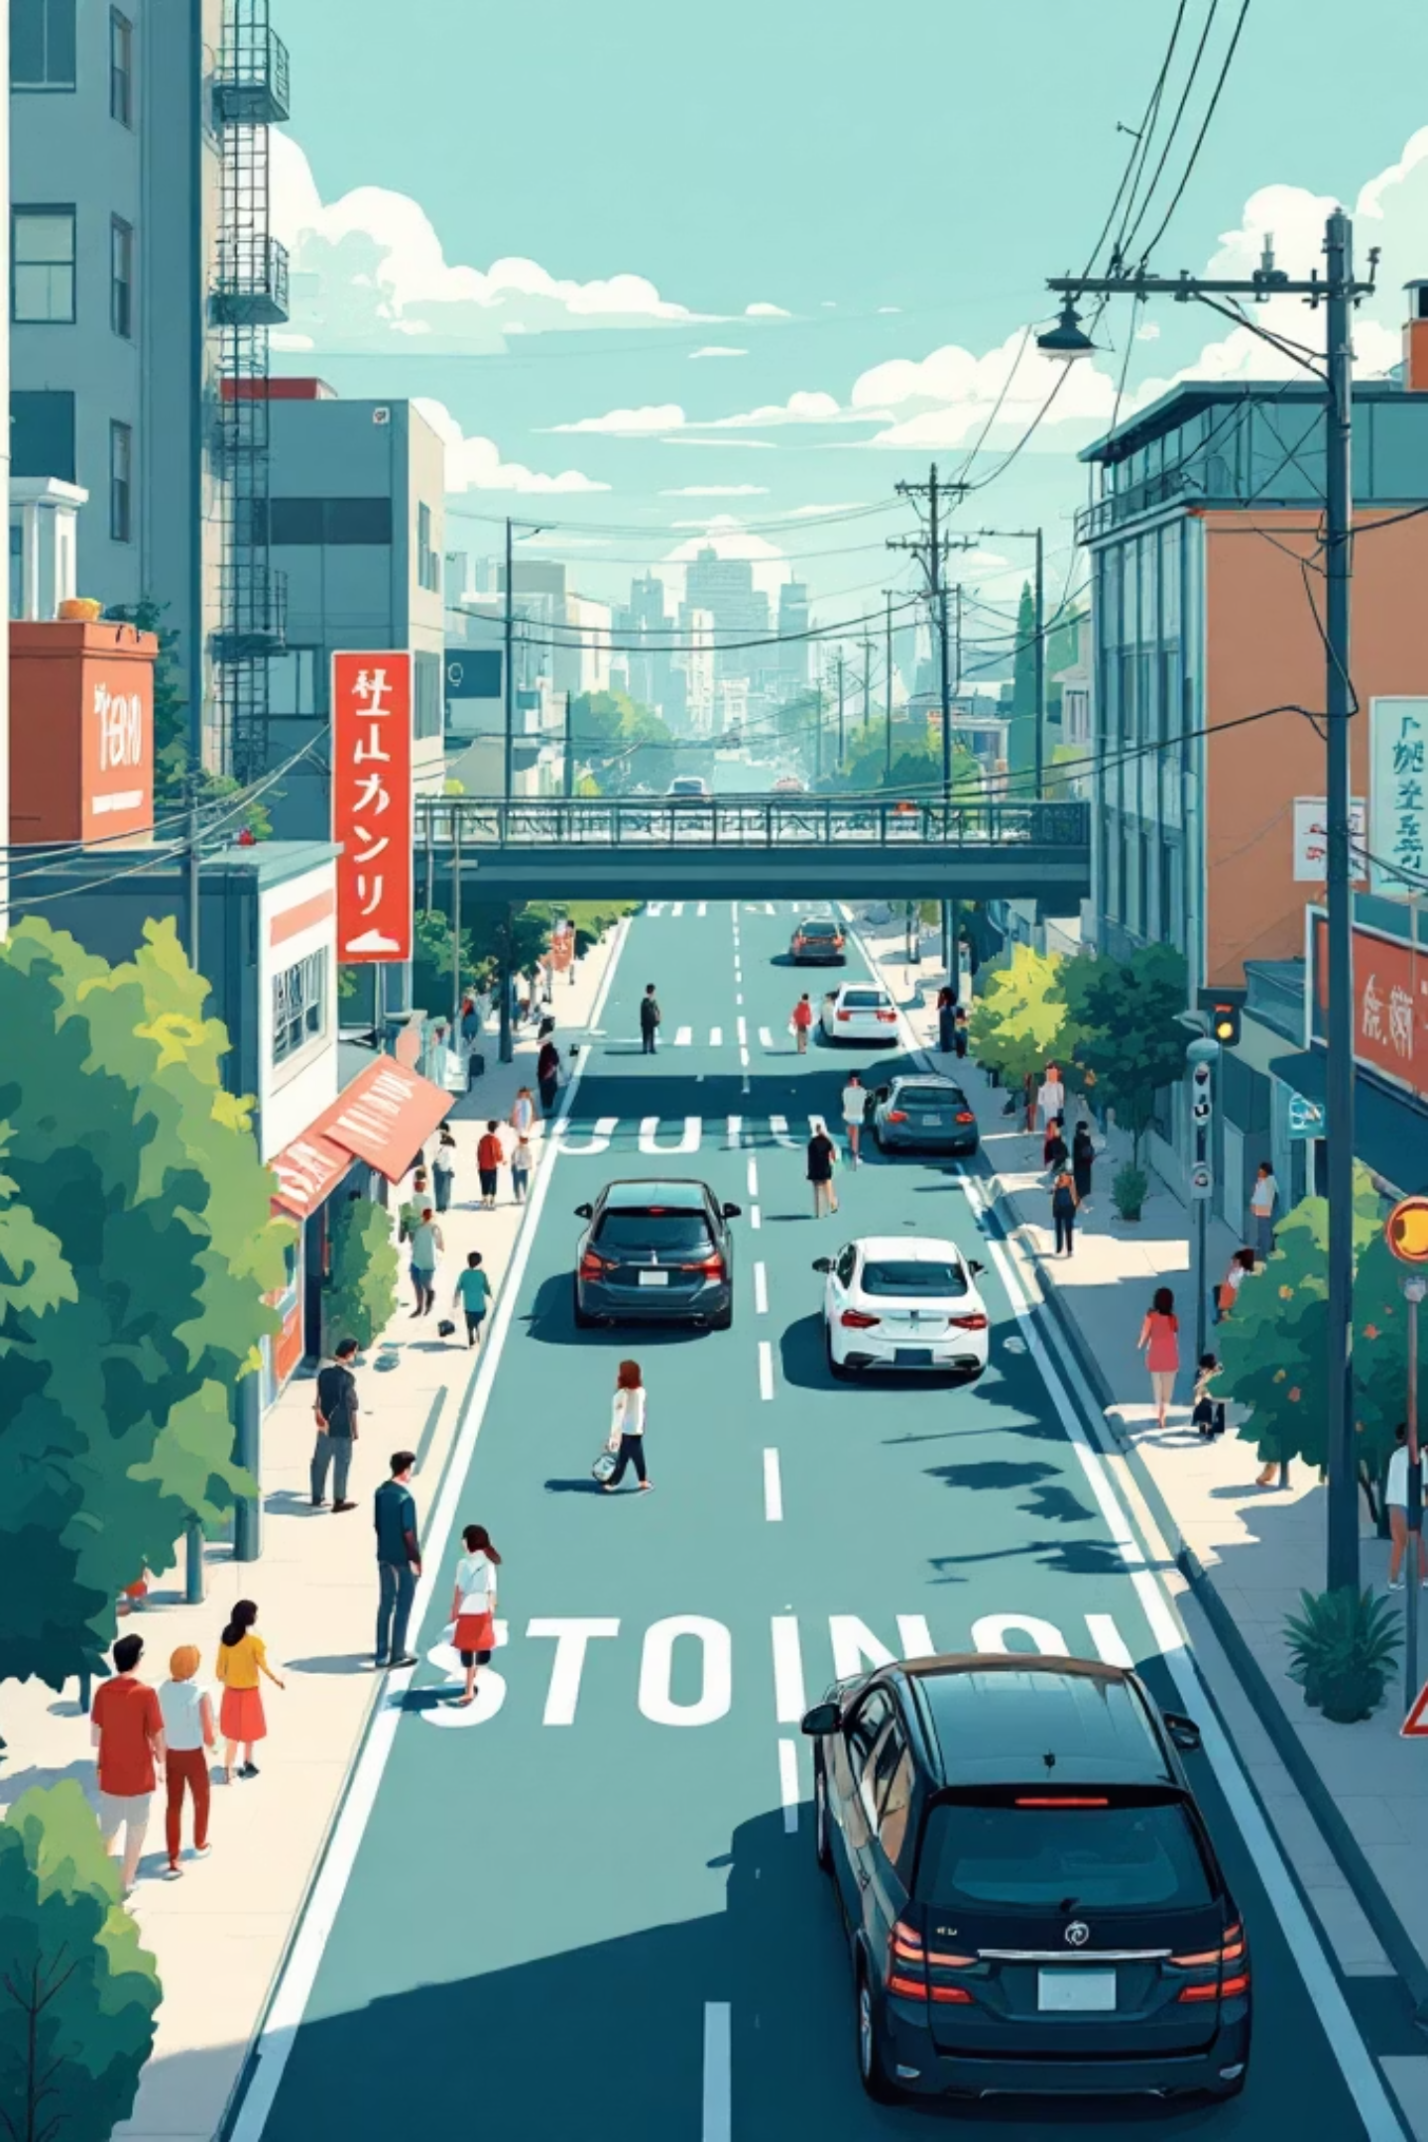
Who needs it?
Tourists – need a car during trips
People without a car – occasional transportation
Car Owners – earn money by renting unused cars
Businesses & Workers – temporary vehicles for work
Notes:
*Mim*

Slide 4
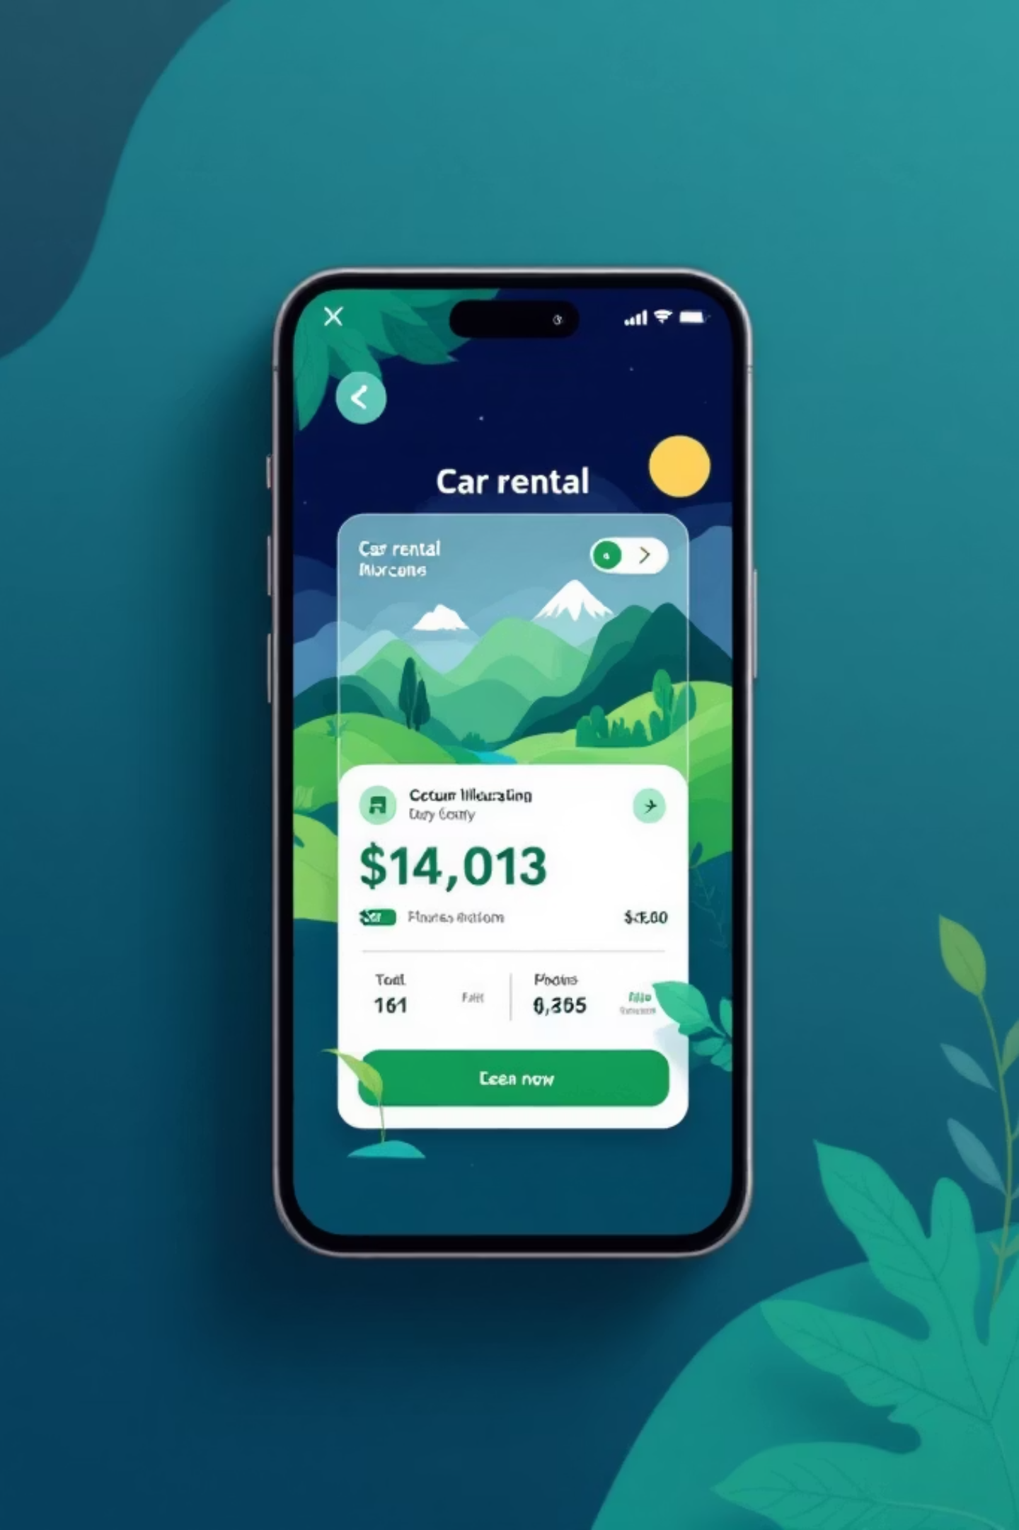
Platform Features
01
User Registration & Verification
Secure account creation with age and identity validation
02
Vehicle Search & Discovery
Location-based listing search with availability filtering
03
Booking Management
Timeframe selection and reservation confirmation system
04
Payment Processing
Secure transactions with receipt generation and tracking
Notes:
*Rishika*

Slide 5
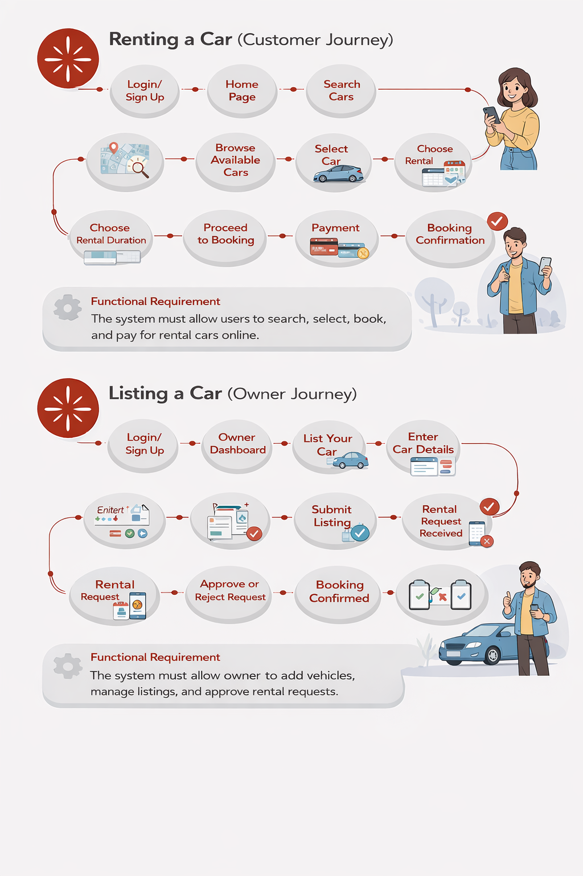
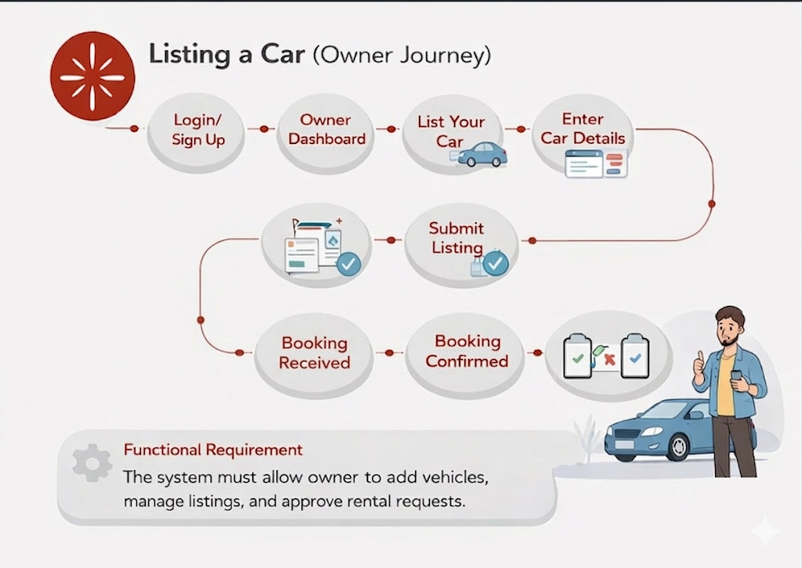
Functional Use Cases
Notes:
*Thierno*

Slide 6
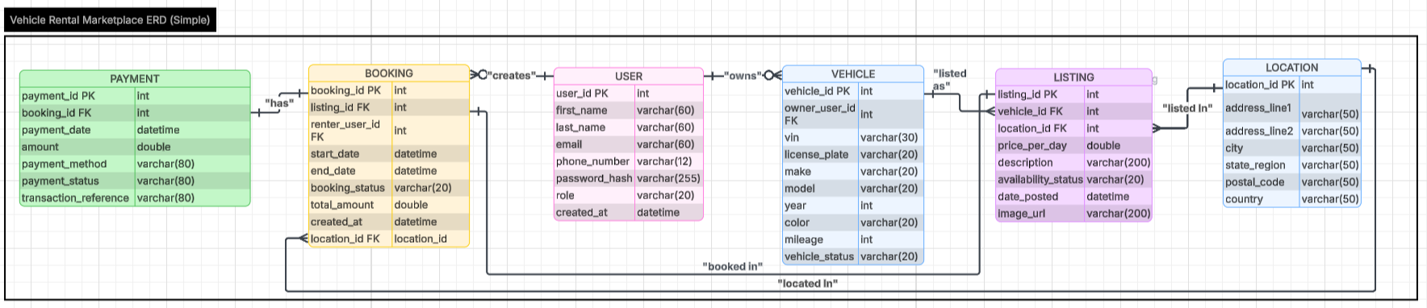
Relational Data Model
Notes:
*Muhammad*

Slide 7



Technology Stack
MySQL Database
React/Next.js Frontend
Python + Flask + Express.js
Relational data storage managing users, vehicles, and transactions
Dynamic user interface with HTML, CSS, and JavaScript components
Backend API handling business logic and request processing
Notes:
*Tyler*

Slide 8
Infrastructure & Analytics
Docker Deployment
Reporting Dashboard
Containerized environment ensuring consistent deployment across development and production systems. Muhammad leads container orchestration and infrastructure management.
Tableau or Plotly integration for real-time analytics and business intelligence. Mim develops visualization tools to track platform performance and user engagement metrics.
Notes:
*Tyler*

Slide 9




Team Structure
Database Team
Frontend Team
Guillermo, Thierno and Tyler collaborate on schema design and data architecture
Mim, Rishika, and Thierno building responsive user interfaces and client experiences
Backend Team
Reporting Team
Muhammad, Tyler, Guillermo developing API endpoints and server logic
Mim and Rishika creating dashboards to measure platform success and user behavior
Notes:
*Tyler*

Slide 10
How do we make money?
Listings are priced per day.
Ex: $100 per day
Our Commission: 10%
Delivery fee: Distance based
Booking Fee: $5-$10 per rental
Data Insights (Profiling from Data)
  The app could collect useful data such as:
Popular rental locations
Demand by city
Most rented car types
Average rental prices
Notes:
*Guillermo*

Slide 11

Why invest in us?
Low operating costs
High user demand
Expandable platform
Recurring revenue
Notes:
*Guillermo*
Low operating cost: App is used to host user vehicles rather than our fleet, less upfront and maintenance costs
High user demand: Many people need cars for special occasions rather than everyday use, and many people have cars they don’t use
Expandable Platform: Able to add more features and deploy to more areas with time
Recurring revenue: Each listed vehicle can generate income multiple times per month, where one car can be rented to multiple customer which create a ongoing cash flow

Slide 12



Next Steps
Database Implementation
API Development
UI/UX Design
Muhammad and Tyler build backend endpoints for frontend integration
Thierno, Mim and Rishika create wireframes and user journey maps
Guillermo leads schema creation and relationship mapping
Collaborative sprint planning ensures parallel progress across database, frontend, and backend teams. Weekly syncs maintain alignment on decisions and requirements.
Notes:
*Rishika*

